Slide 1
Global comparative advantages and supply chain disruptions
Pascalis Raimondos
Head, School of Economics and Finance, QUT Business School

Slide 2

Road map of today’s talk
A brief introduction
Comparative advantage (CA)
Global (dynamic) comparative advantages
Global value chains (GVC)
Disruption: COVID19 and anti-globalisation

Slide 3

2. Comparative advantage: David Ricardo (1772-1823)
First to use the term comparative advantage in his 1817 book when arguing against the ‘Corn Laws’ introduced in England in 1804.
Specialize in what you are relatively most productive and trade the rest
The leap from Adam Smith’s absolute advantage is massive: while you may be bad in everything, you always have a comparative advantage in something.

Slide 4
The Paul Samuelson story
Challenged to “name one proposition in all of the social sciences which is both true and non-trivial”, Samuelson offered the idea of comparative advantage:
  “That it is logically true need not be argued before a mathematician; that is non-trivial is attested by the thousands of important and intelligent men [sic] that have never been able to grasp the principle of CA or believe it even after it was explained to them.”
But is it empirically relevant?
Yes. Comparative advantage can explain approx. 21% of trade (Costinot and Donaldson, American Economic Review 2012).

Slide 5
3. Global (Dynamic) Comparative Advantages
Has the importance of comparative advantage changed over the years?
Yes, comparative advantage is getting weaker. The countries/sectors with the lowest initial productivity have experienced the largest productivity gains. Globalization has led to a convergence (Levchenko and Zhang, Journal of Monetary Economics 2017)

Slide 6
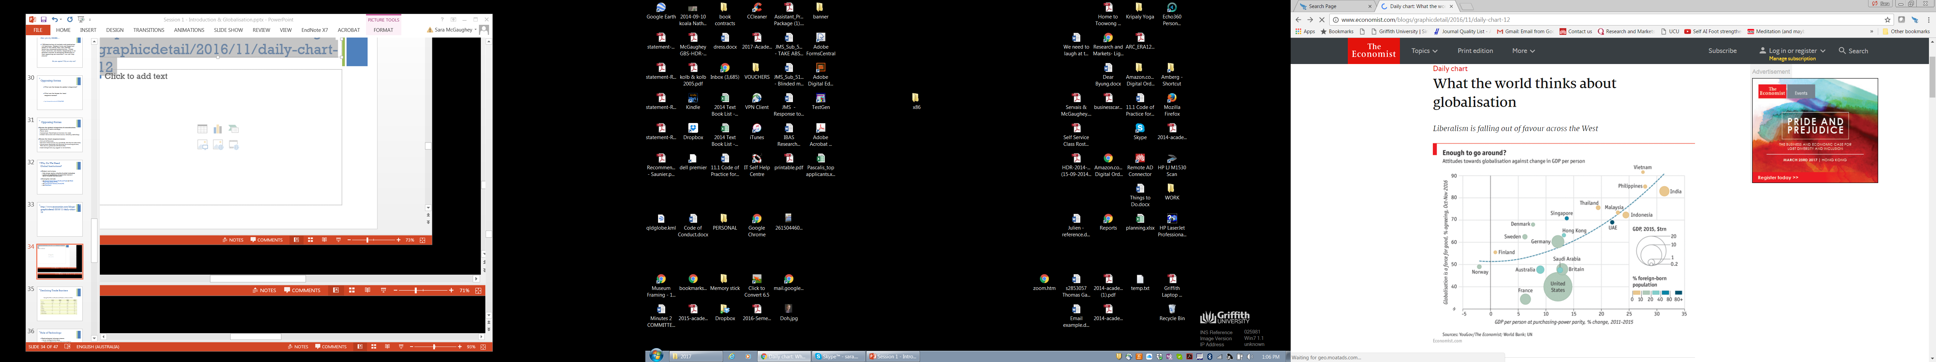
Convergence has affected attitudes re. globalization

Slide 7
What forces bring this convergence?
Factor price convergence
Multinational Enterprises (firm-scale effects)
Global Value Chains (a combination of scale and comparative advantage effects)

Slide 8
4. Global Value Chains (GVC)
A vertical de-integration of production where intermediate goods are made where efficient.
The “build or buy” decision became global... A firm prefers to buy an input from a specialised firm somewhere in the world.
Whether the relation is at arm’s length or not is not (as) important.

Slide 9
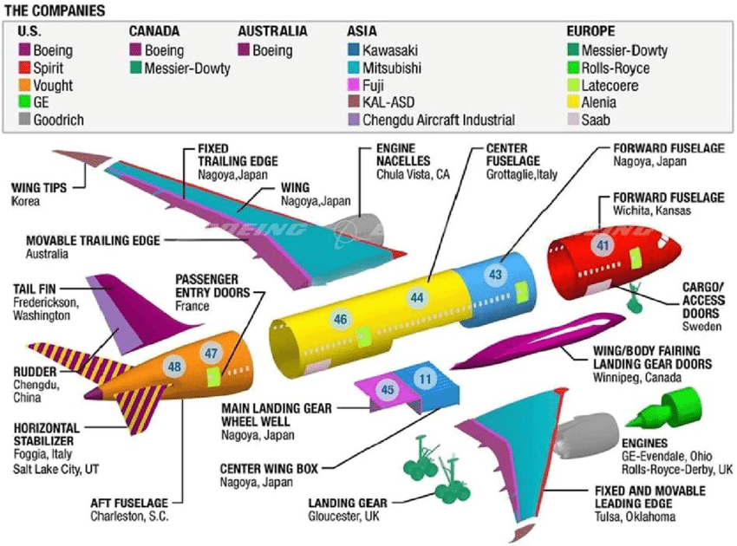
The case of Boeing

Slide 10
Effects of GVCs on trade statistics
(Direct)

Slide 11
Effects of GVCs on Trade Statistics
VAX: ratio of VA exports to (direct) gross exports, i.e. a measure of domestic content of exports
Bilateral VAX > 1: AUS exports reach the destination both directly and indirectly
Bilateral VAX < 1: AUS exports goods that contain a lot of imports from other countries.

Slide 12
Effects of GVCs on Trade Policy
GVCs amplify the effects of tariffs:
Since tariffs are applied to the gross value of a good when it crosses the border, rather than just the ‘new’ value added, every border crossing increases the total tariff bill associated with production.
As more trade is among GVCs, one would expect GVCs to have a trade-liberalizing effect (see here and here).

Slide 13
5. Disruption: COVID19 and anti-globalisation
It is important to manage risks arising from GVCs, i.e. geographic dispersion of supply chains is important (the case of medical products under COVID19 is an excellent example - listen podcast).
Globalisation has been under attack for a while due to the income inequality that it can create.

Slide 14
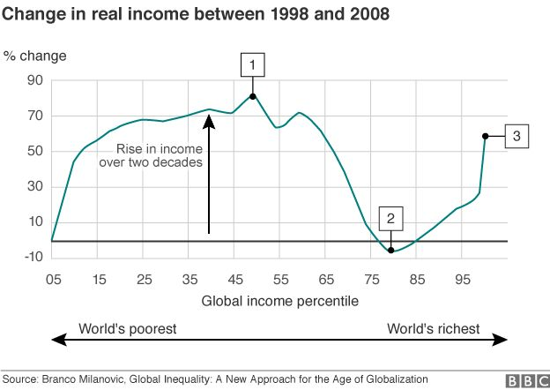
Globalization and inequality: The “elephant” figure
Middle classes in countries such as China, India and Brazil
Lower earners in countries such as the USA and UK
The richest individuals around the globe
(2016)

Slide 15
Gains from Trade…. but not for all
Trade is competition and competition is good (it increases productivity).
However, trade can harm “..those that work in industries that compete with imports.”

Slide 16
Trade policy?
Trade policy is ineffective for protecting from foreign competition for a simple reason: it leads to retaliation (e.g. oranges & steel). Trade wars are always harmful and do not last long for this exact reason.
Governments should instead provide the infrastructure for people/firms to adapt and grow (e.g. education, innovation, business environment, etc.) The role of the state becomes even more important in a globalised world.
Thank you (pascalis.raimondos@qut.edu.au)

