Slide 1

Economic Update
22 November 2025
Presented to Queensland Economic Teachers Association AGM
Michael Anthonisz, Chief Economist
manthonisz@qtc.com.au or economics@qtc.com.au

Slide 2
Agenda
Global economy
US trade policy
US fiscal risks
Could we see a correction to the AI-fuelled equity rally?
National economy
State economy
Case study – Infrastructure construction

Slide 3
Global economy – US trade policy

Slide 4
US trade policy – State of play
Country/product | Tariff rate
China | 20%
Switzerland | 39%
Canada | 35%
Mexico, India | 25%
Taiwan, Vietnam, Bangladesh, Sri Lanka | 20%
Indonesia, Philippines, Cambodia, Malaysia, Thailand, Pakistan | 19%
EU, Japan, South Korea, NZ (& 36 other countries) | 15%
Others cited in Whitehouse press release | 15% to 41%
Other (including Australia, Brazil, UK and others not in press release) | 10%
Autos | 25%
Steel and aluminium | 50%
Copper (semi-finished) | 50%
Pharmaceuticals | 100%
Semiconductors | TBC
Source: Whitehouse
There are a wide range of tariff outcomes for different countries…
…but all the measures have the same effect on prices paid by US consumers
Notes:
Lets start with the big news – China..
LHS graph shows growth weakest in 2 years – and driven by weakness in the property sector – RHS graph shows spike in houses built now big drop off (YonY) especially real estate (Grey line) – they have built to0 many houses and know this is a big drag to their economy!
And while they are working hard to correct this situation…”throwing the kitchen sink at it” …outcomes of this still to play out – they have been quite good at this (ie generating growth) in the past eg belt and roads initiatives, house (city) building and now they are pushing EVs / Solar…
Remembering that when China or the US sneeze…the rest of the world catches a cold… – so very good for Aus that they are doing this…
An interesting fact, provided some context…
China’s exports of steel have doubled since 2020 and are now enough to build a thousand Golden Gate bridges each year
AND Despite only one per cent of steel mills in China currently being profitable, more steel capacity will come online by the end of next year than will be shut down

Slide 5
US trade policy – Impact on US economy
How much has US raised from tariffs?
Has trade in some industries been diverted?
How much are tariffs impacting US inflation?
US jobs growth has slowed markedly…
…while US CPI is uncomfortably high

Slide 6
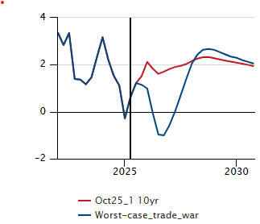
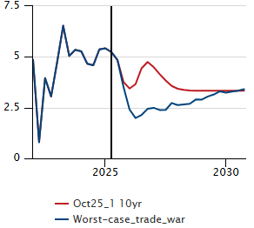
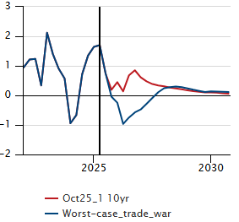
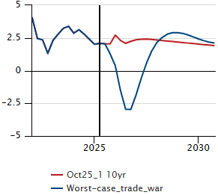
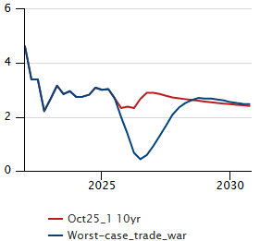
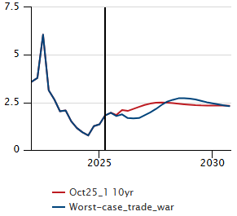
US trade policy – What does an adverse trade shock look like?
China real GDP (CNY, yoy, %)
Korean real GDP (JPY, yoy, %)
Japan real GDP (JPY, yoy, %)
US real GDP (JPY, yoy, %)
Use a clear definition of ‘shock’. Pls give some examples of shocks in the past.
Why is Australia expected to experience less of a shock from US trade policy?
Global real GDP (US$, yoy, %)
Australia real GDP (US$, yoy, %)
Scenario
The US removes key tariff exemptions and raises tariffs again. Such that effective tariff rate rises to 34% by Q4 2025 (2x baseline). China faces an effective tariff rate of over 120%. Affected economies retaliate.
Impacts
The US economy contracts in late 2025 and 2026 given supply chain disruptions (as bad as 2021) and lower investment. World trade contracts and is still ~10% below baseline by end of the decade.
Global growth slows to 0.7% in 2026
Higher inflation initially delays US rate cuts, but policy rates then fall sharply, to below 1.5% in 2027.
Oil prices fall 20% below baseline by end-2026.
Source: Oxford Economics

Slide 7
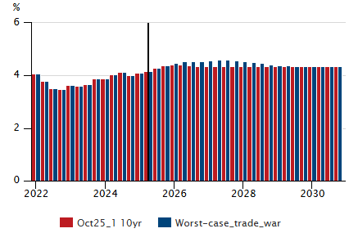
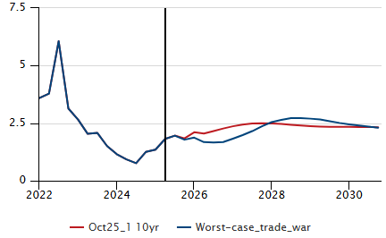
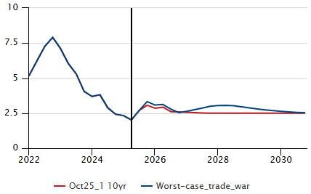
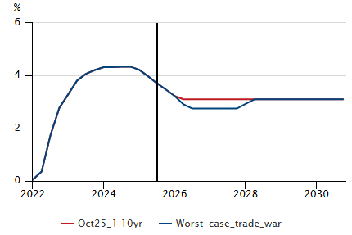
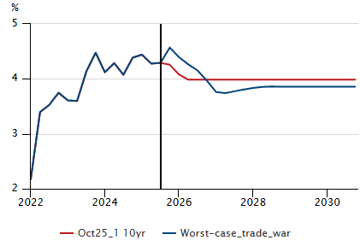
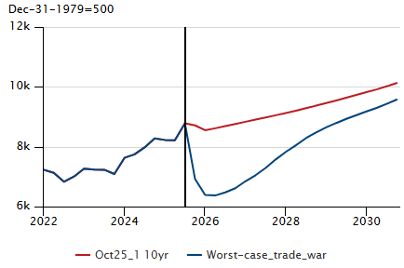
US trade policy – Australia in an adverse trade shock
Source: Oxford Economics
Real GDP (yoy, %)
Unemployment rate (%)
CPI (yoy%)
RBA Cash Rate (%)
Why so much impact on equities?
Bond yields (%)
Equities

Slide 8
Global economy – US fiscal risks

Slide 9
US fiscal challenges
What are some examples of distinct fiscal strategies?
Great graph of structural vs cyclical forces on the budget!
Notes:
Lets start with the big news – China..
LHS graph shows growth weakest in 2 years – and driven by weakness in the property sector – RHS graph shows spike in houses built now big drop off (YonY) especially real estate (Grey line) – they have built to0 many houses and know this is a big drag to their economy!
And while they are working hard to correct this situation…”throwing the kitchen sink at it” …outcomes of this still to play out – they have been quite good at this (ie generating growth) in the past eg belt and roads initiatives, house (city) building and now they are pushing EVs / Solar…
Remembering that when China or the US sneeze…the rest of the world catches a cold… – so very good for Aus that they are doing this…
An interesting fact, provided some context…
China’s exports of steel have doubled since 2020 and are now enough to build a thousand Golden Gate bridges each year
AND Despite only one per cent of steel mills in China currently being profitable, more steel capacity will come online by the end of next year than will be shut down

Slide 10
US fiscal challenges

Slide 11
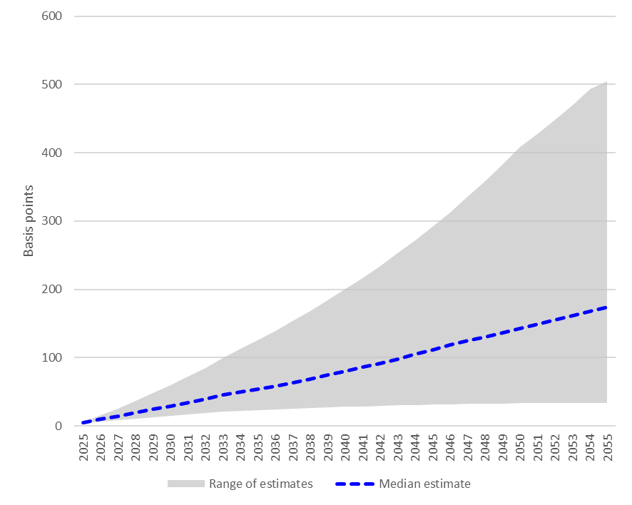
US fiscal challenges
Impact on US Treasury real yields under different debt scenarios
Note: Debt scenarios from CBO's May 2025 report ‘The Long-Term Budget Outlook Under Alternative Scenarios for the Economy and the Budget’. Sensitivity of yields to debt based on QTC analysis of studies referred to here

Slide 12
US risk premium – could this affect the US Dollar’s status as THE global reserve currency
Why might the US’ role as THE global reserve currency decline?
Possible “weaponisation” of the Dollar via sanctions
Geopolitical alignment in a multi-polar world
Governance concerns (willingness to repay debt)
Fiscal concerns (ability to repay debt)
Rising role for alternatives
A great question!
Areas where there might be rising governance concerns for the US
Political process
Separation of powers
Rule of law
Independence of institutions
Capacity of institutions to discharge public good
Credibility of policymaking

Slide 13
Global economy – Could we see a correction to the AI-fuelled equity rally?

Slide 14
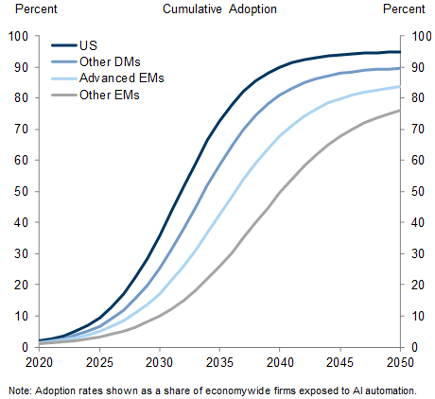
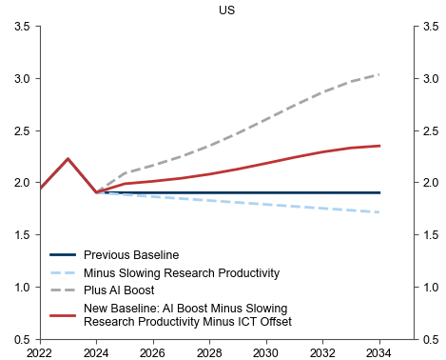
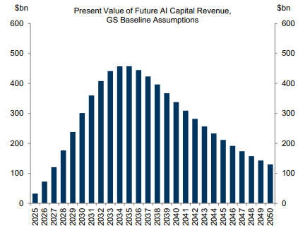
AI adoption
~1/2 ppt
We are here
AI adoption is just beginning…
…which could lead to big gains to economic growth…
…and revenues for AI firms
Source: The AI Spending Boom Is Not Too Big, Goldman Sachs, 15 October 2025
Source: The AI Transition One Year Later: On Track, but Macro Impact Still Several Years Off (Goldman Sachs, 2 April 2024)
Source: Upgrading Our Longer-Run Global Growth Forecasts to Reflect the Impact of Generative AI, Goldman Sachs, 29 October 2023

Slide 15
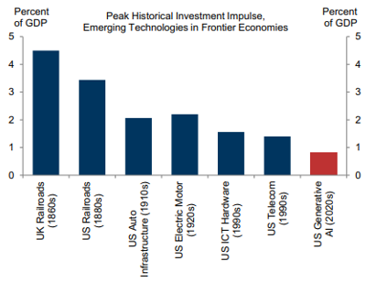
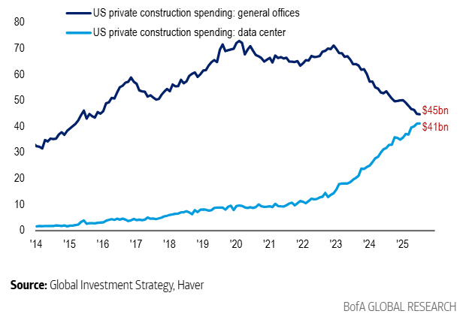
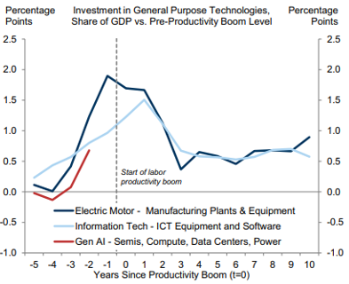
AI & investment
There are concerns about over-investment…
…but the AI capex spend is so far small relative to other transformational technologies…
…with it likely to keep rising for some time yet
Source: The Flow Show, BofA, 25 September 2025 and Global Fund Manager Survey, BofA, 16 September 2025
Source: The AI Spending Boom Is Not Too Big, Goldman Sachs, 15 October 2025

Slide 16
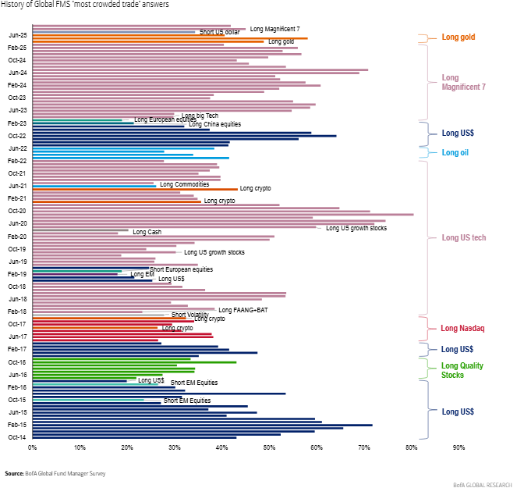
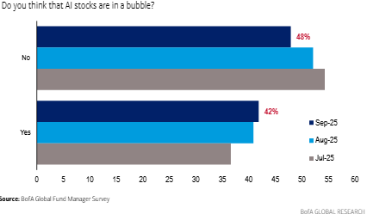
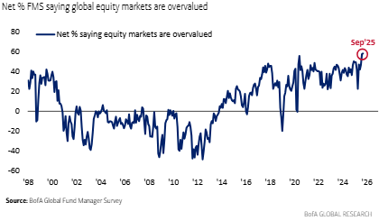
US equity valuations
Key points
More than 40% of investors think AI stocks are in a bubble
Long US tech/Mag 7 has been seen as the most overcrowded for most of the time since the start of 2018
The biggest share of market participants consider equities to be overvalued since 1998 (i.e. including dot com boom)
Source: The Flow Show, BofA, 25 September 2025 and Global Fund Manager Survey, BofA, 16 September 2025

Slide 17
National economy

Slide 18
Australian economy – business cycle
Leading indicators of economic activity suggest the Australian economy remains in a recovery phase…
…while similar measures for the labour market give a similar signal

Slide 19
Australian economy – supply and demand
First graph will need to be explained with a bit of detail – it has a lot of information to connect to demand and supply forces.
The reference to inflation re the first graph – can this be to demand pull inflation?
Connect product demand to labour demand – demand for labour being derived from the demand for products.
The demand-supply balance in product markets is consistent with rising inflation
…while that in labour markets is suggesting slowing wages growth

Slide 20
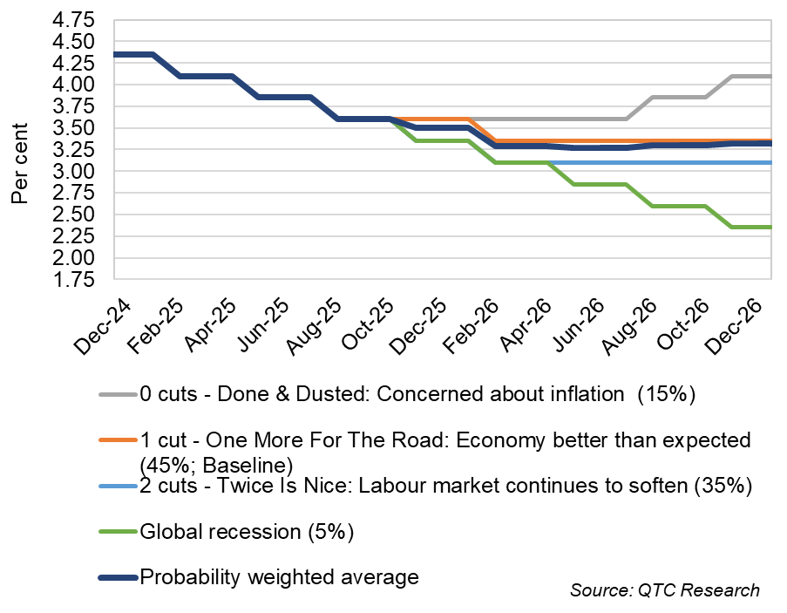
Might the RBA start hiking rates?
RBA Cash Rate Scenarios
Our latest forecasts and scenario analysis was finalised prior to the Q3 CPI data. The next update will likely see a baseline of no more cuts with this having a probability of 40%, one more cut (30%), earlier hikes (20%), two more cuts (5%), global recession (5%).

Slide 21
State economy

Slide 22
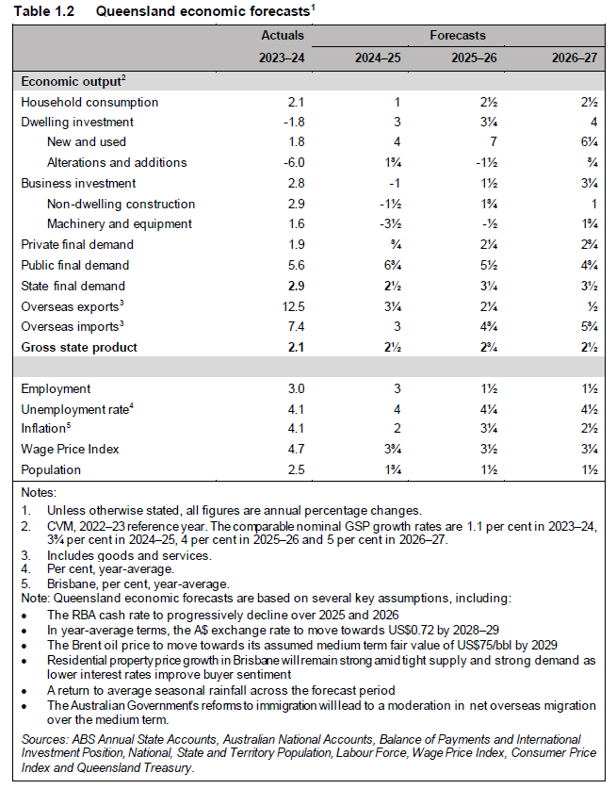
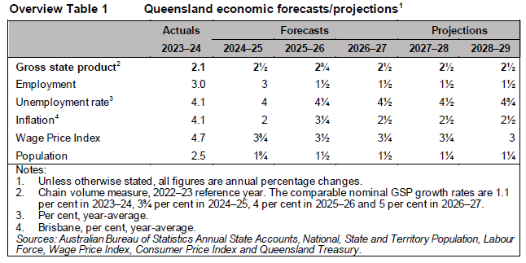
Forecasts
The general story per the forecasts are for:
QLD’s GSP growth is forecast to strengthen to 2½ per cent in FY25 given government service delivery and a large capital program. It should then strengthen slightly to 2¾ per cent in FY26 as private sector activity picks-up before easing back to 2½ pr cent across the rest of the FEs.
Population growth is projected to moderate across the forecast period, slowing from 2.5 per cent in FY24 to 1¾ per cent in FY25 and then 1½ per cent in FY26 and FY27. A key driver of this moderation is the reduction in the Australian Government’s immigration program.

Slide 23
Cross-state forecasts – Population
What are the economic implications of slower population growth?
Population growth in QLD is set to slow in line with changes in the Australian Government’s immigration program. It is set to be below WA and VIC but above NSW. Questions have been raised about VIC’s population forecasts.

Slide 24
Cross-state forecasts – GSP growth
Note Queensland has a higher volatility than NSW and Vic – why?
Does the high nominal peak of Qld QSP mean QLD have relatively higher inflation At this point?
QLD real GSP growth is expected to be one of the fastest of the major states over the next few years with very little difference expected in nominal GSP growth rates (apart from WA which is set to be weaker)

Slide 25
Cross-state forecasts – Labour market
The labour market is set to be slightly softer in QLD than in major states over the next few years based on the outlook for employment growth and the unemployment rate

Slide 26
Case study – Infrastructure construction

Slide 27
Construction activity and costs
There is a reasonable amount of work being done on infrastructure projects in QLD…
…and thankfully growth in the cost of delivering these is slowing

Slide 28
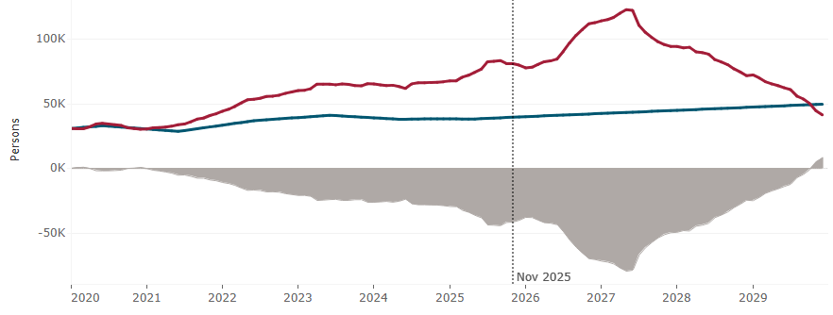
Construction labour and materials
Supply-demand balance – Construction labour on major public infrastructure projects
Source: Public Infrastructure Workforce Supply Dashboard, Infrastructure Australia
Proxies for conditions in global markets for materials have normalised…
…while in markets for construction labour in QLD, this is likely some years away

Slide 29
Construction activity and costs
Cost drivers
Engineering construction work yet to be done (outside heavy industry), is close to record highs in QLD, suggesting a reasonable pipeline of work…
…with this consistent with projections at the national level for drivers of costs being seen as stabilising at current levels rather than falling further

Slide 30
Disclaimer
QTC has prepared this presentation for the Queensland Economic Teachers Association.
The recipient shall not use the presentation for any purpose other than the purpose for which the presentation was expressly provided. The presentation contains confidential information. None of its contents may be provided or disclosed to any other party without QTC’s express written consent.
The information in this presentation is provided by QTC in good faith in relation to the information available at the time of its preparation and on the basis of information supplied to QTC by third parties. QTC has not independently verified the information supplied to it and accordingly does not represent that the information provided to QTC is accurate or complete and it should not be relied upon as such. QTC is under no obligation or duty to notify anyone if there is any change in any information or any new information or if it forms a different opinion at any time after the date of this presentation.
Neither QTC nor any of its employees or agents accepts any liability for any loss or damage suffered by any person as a result of that person or any other person placing any reliance on, or acting on the basis of, the contents of this presentation. To the extent permitted by law, QTC expressly excludes any representation or warranty in relation to the accuracy, currency and completeness of the presentation. To the extent permitted by law, QTC limits its liability to the amount of any fees paid to QTC for this presentation.
The recipient acknowledges that QTC is not a legal, tax or accounting advisor and that independent expert advice from practitioners in the relevant disciplines should be obtained on those matters before acting upon the information contained in this presentation.
© Queensland Treasury Corporation 2025

